Slide 1
Tools and Tips for Statistical Data Analysis
Jack Huber, Ph.D.
Senior Clinical Data Analyst
Providence Swedish Pharmacy

Slide 2
Observations about statistics in healthcare
We value data.
Statistical literacy varies.
Residents need help with statistics (Newsome et al., 2018; Windish et al., 2007)
Increasingly sophisticated statistics in medical journals (Arnold et al., 2013; Horton & Switzer, 2005; Windish et al., 2007; Yi et al., 2020)
Growing presence of AI / machine learning methods
Service

Slide 3
Where help seems needed
How many patients do I need for statistics?
What statistics should I use with my data?
How do I do a chi-square (or other statistic) in Excel (or other program)?

Slide 4
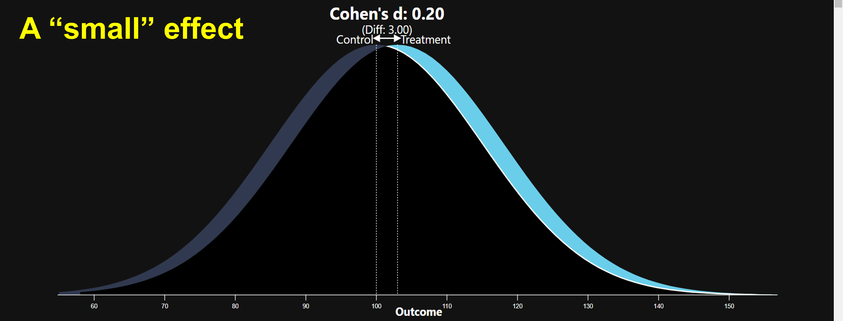
How many patients do I need for statistics? Power analysis: A quick primer on effect sizes

Slide 5
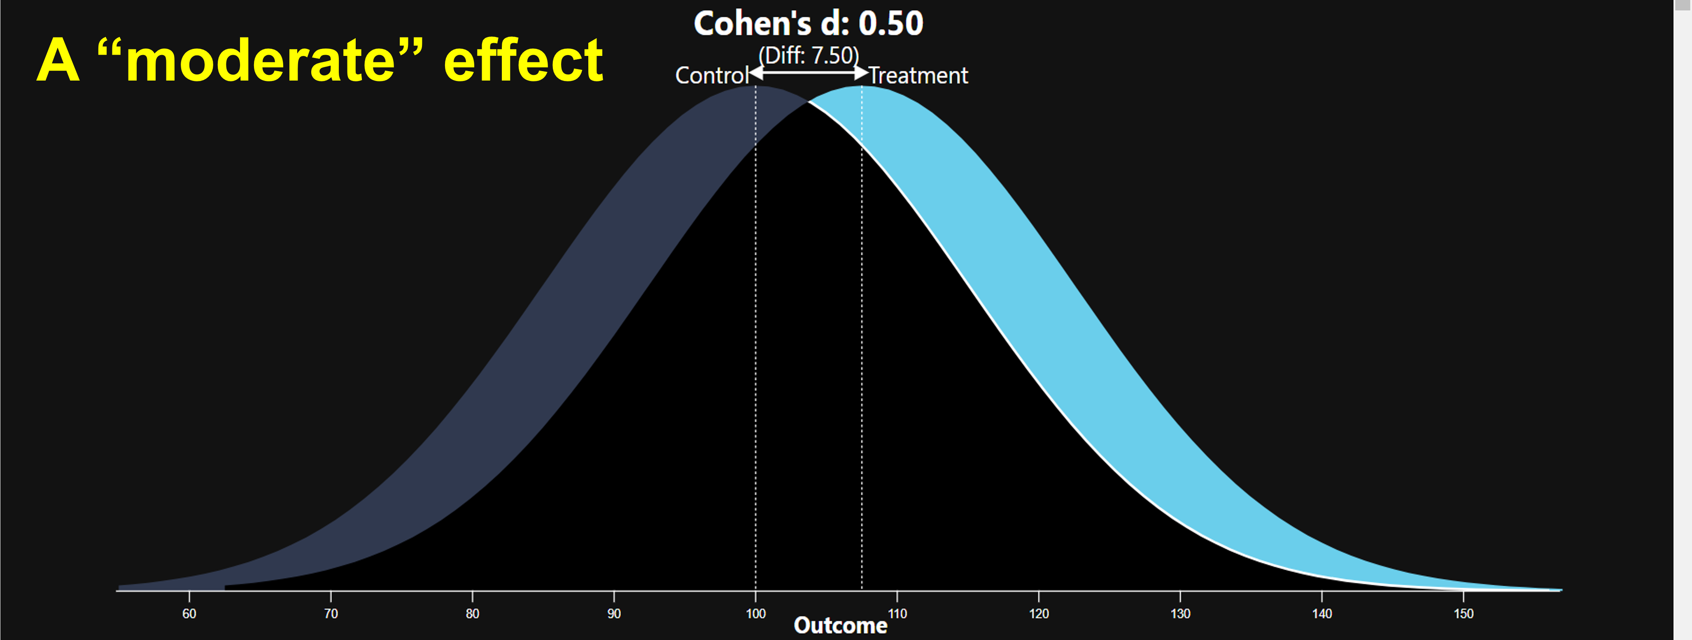
How many patients do I need for statistics? Power analysis: A quick primer on effect sizes

Slide 6
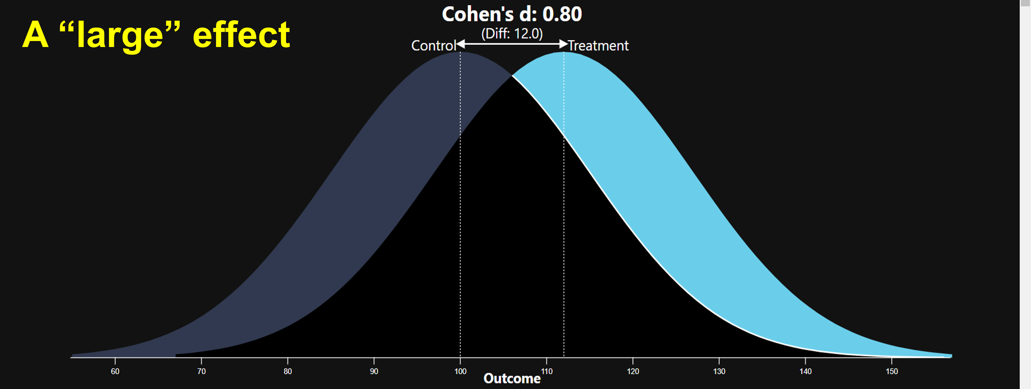
How many patients do I need for statistics? Power analysis: A quick primer on effect sizes

Slide 7
How many patients do I need for statistics? Power analysis
Power: “the ability to find a treatment effect when it really does exist” (Cohen, 1988)
ꭕ² test of independence
(comparing two groups on a dichotomous outcome)
 | Effect size
 | “Large” (0.8) | “Moderate” (0.5) | “Small” (0.2)
Power | .8 | .8 | .8
p-value | .05 | .05 | .05
Sample size | 31 | 87 | 784
SOURCE: pwr package in R

Slide 8
What statistics should I use? Understand the measurement level of the outcome variable
A quick review of measurement levels (Simpson, 2015)
Measurement level | Measurement level | Simple definition | Simple examples
Categorical | Nominal / dichotomous | Patients in unordered categories | Mortality (Y/N)
 | Ordinal | Patients in categories that progress in meaningful order | Counts of hospital stays Levels of oxygen support
Continuous | Interval | Patients on a continuous scale but no true zero. Arithmetic is permitted. | Temperature
 | Ratio | Patients on a continuous scale that includes a true zero. Arithmetic is permitted. | Blood pressure Length of stay Days to readmission

Slide 9
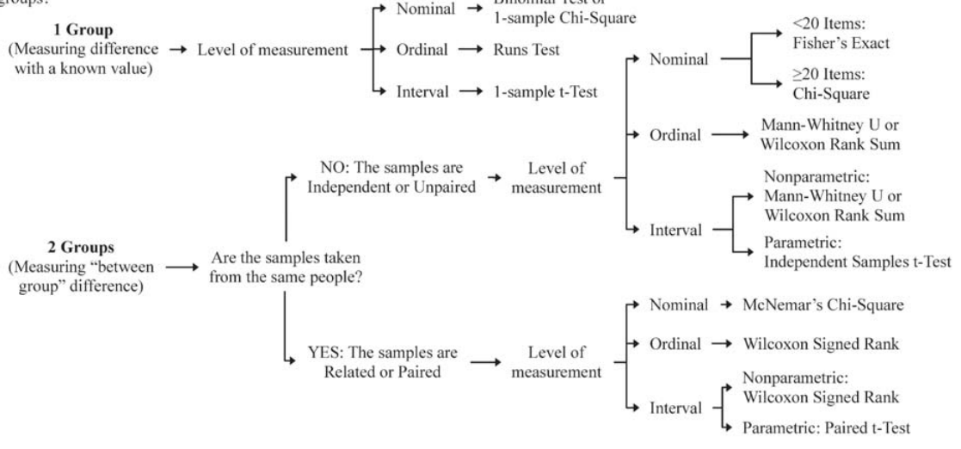
What statistics should I use? A decision tree for selecting statistics
Simpson, SH. 2015. “Creating a Data Analysis Plan: What to Consider When Choosing Statistics for a Study.” Canadian Journal Hospital Pharmacy 68(4):311-7.

Slide 10
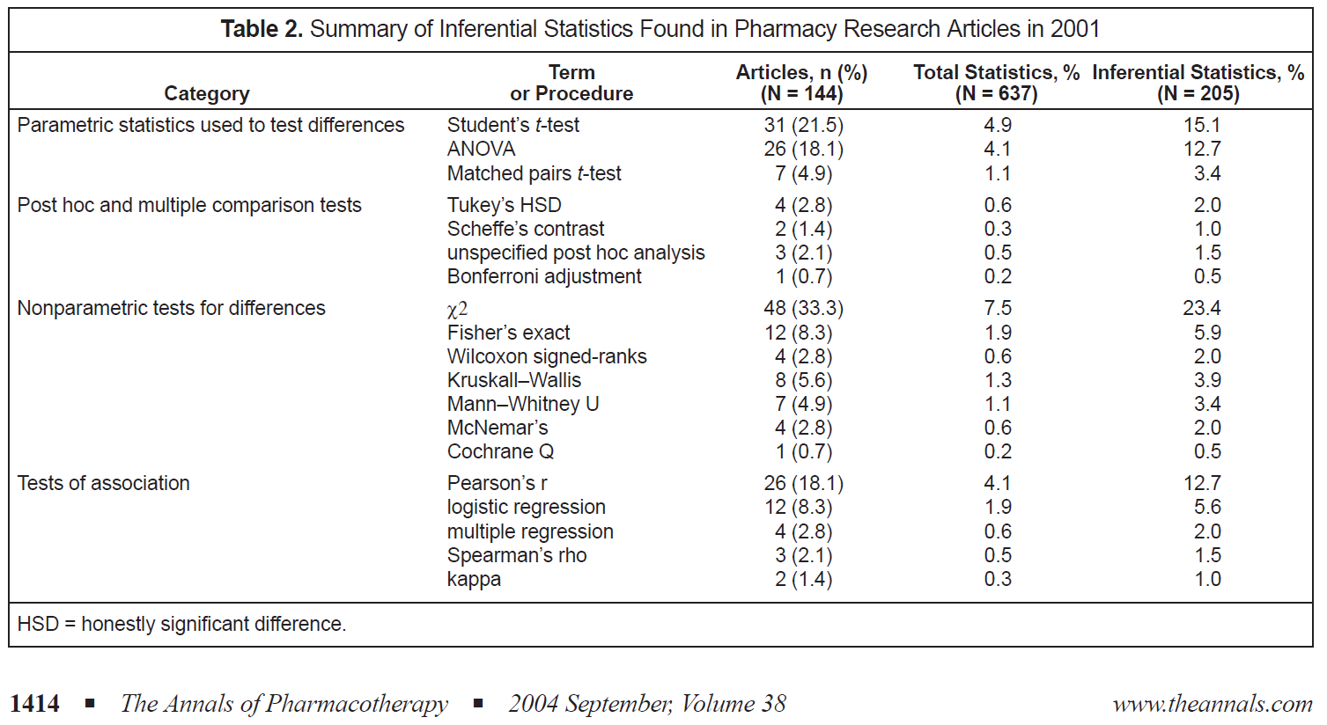
What statistics should I use? What statistics get published?
Most frequently used statistics in pharmacy literature (Lee, Soin & Einarson, 2004, “Statistics in the Pharmacy Literature”, Annals of Pharmacotherapy)

Slide 11
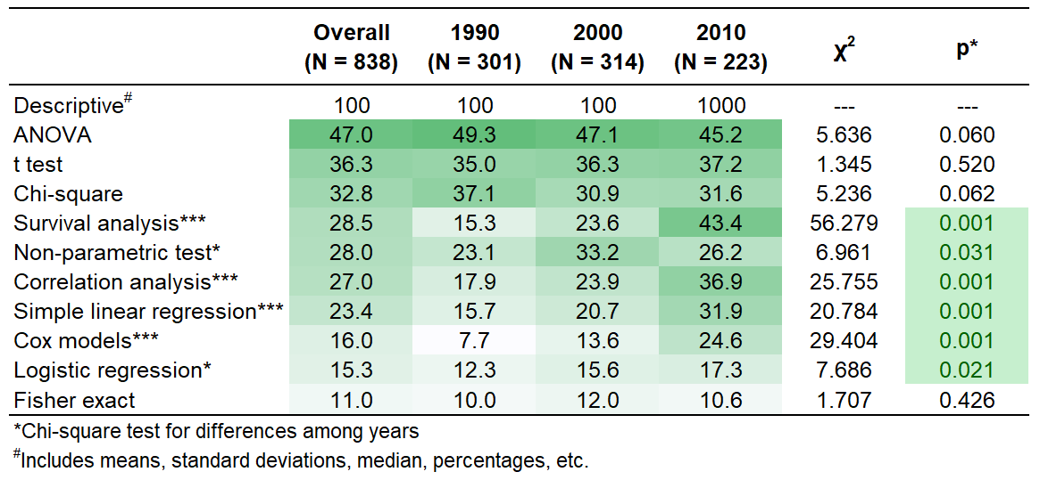
What statistics should I use? What statistics get published?
Most frequently published statistics in NEJM, Lancet, JAMA, Nature (Yi et al., 2015, “Statistical Use in Clinical Studies: Is there Evidence of a Methodological Shift?” PLOS One)

Slide 12
Statistics in medical literature: two conclusions (Simpson, 2015)
Medical journals publishing increasingly sophisticated statistics, AND
You can still publish with these comparatively simpler statistics:
t tests
Contingency table tests (chi square ꭕ² and Fisher exact test)
Simple correlation analyses
Simple regression analyses

Slide 13
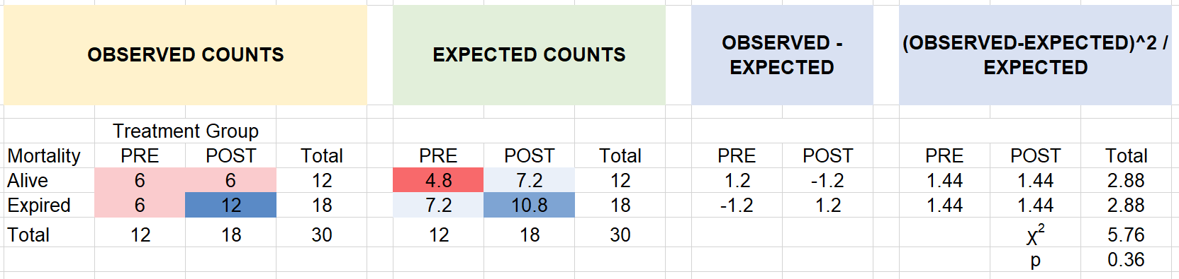
How do I do a chi-square (in Excel)? A quick review of the statistic
Calculate difference between observed and expected
Sum difference between observed and expected and evaluate probability
How would they fill the variables were independent?
We observe patients fill categories

Slide 14
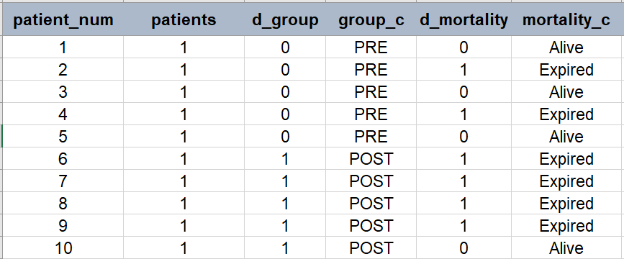
How to do a ꭕ² test in Excel template Step 1. Format your raw data for PivotTable
All patients in the same data array
Column with codes identifying patient groups
Outcome variable
Sample Chi-square data and formulae.xlsx

Slide 15
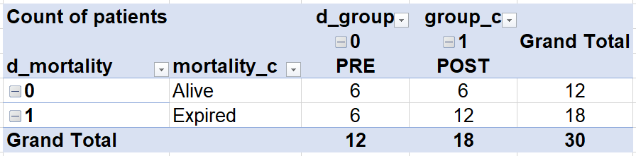
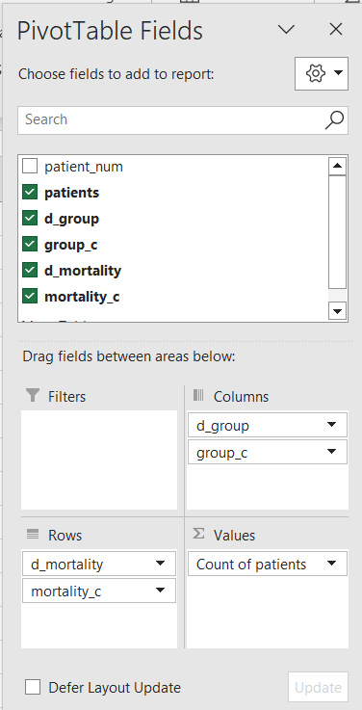
How to do a ꭕ² test in Excel template Step 2. Use PivotTable to get observed counts
PivotTable settings
Values → patients → Field settings → Count
Design → Report Layout → Show in Tabular Form
Sample Chi-square data and formulae.xlsx

Slide 16
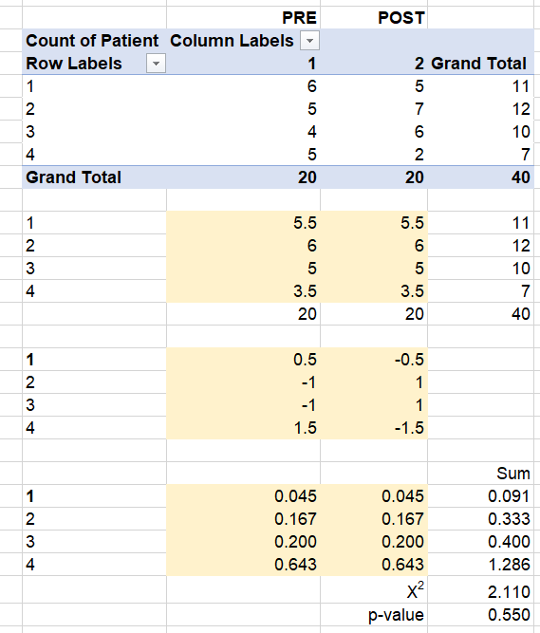
How to do a ꭕ² test in Excel template Step 3. Expected counts, residuals, ꭕ², p, calculated for you
Observed counts
Expected counts
Patients expected if treatment and outcome are independent
Formulas calculate for you
Residual (Observed – Expected)
Difference between observed and expected patient counts
Square residuals
Difference between observed and expected patient counts
ꭕ² and p-value
Sample Chi-square data and formulae.xlsx

Slide 17
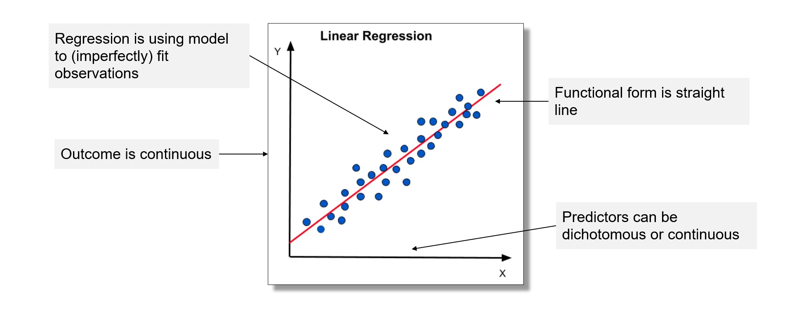
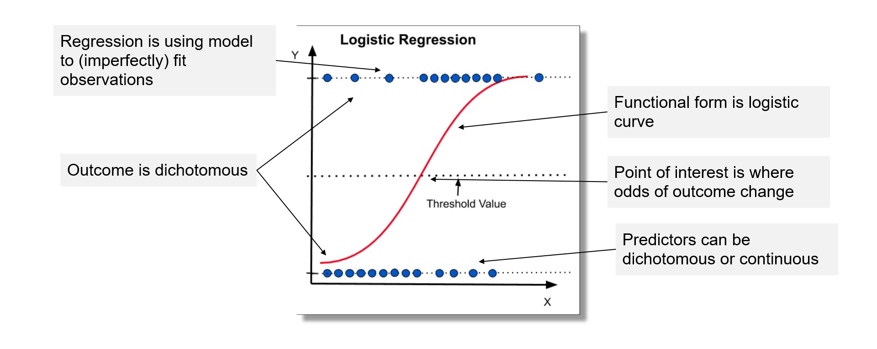
How do I do a logistic regression? A gentle review of the statistic

Slide 18
Why logistic regression?
Can isolate relationship between predictor and outcome controlling for additional explanatory variables
Can examine interactions between multiple predictors on outcome variable (Does the effect of X on Y depend on the level of W?)

Slide 19
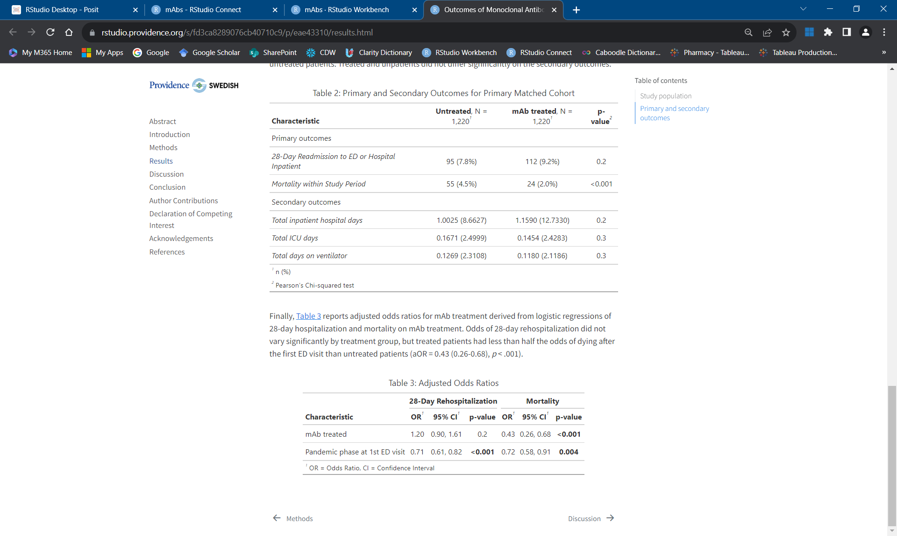
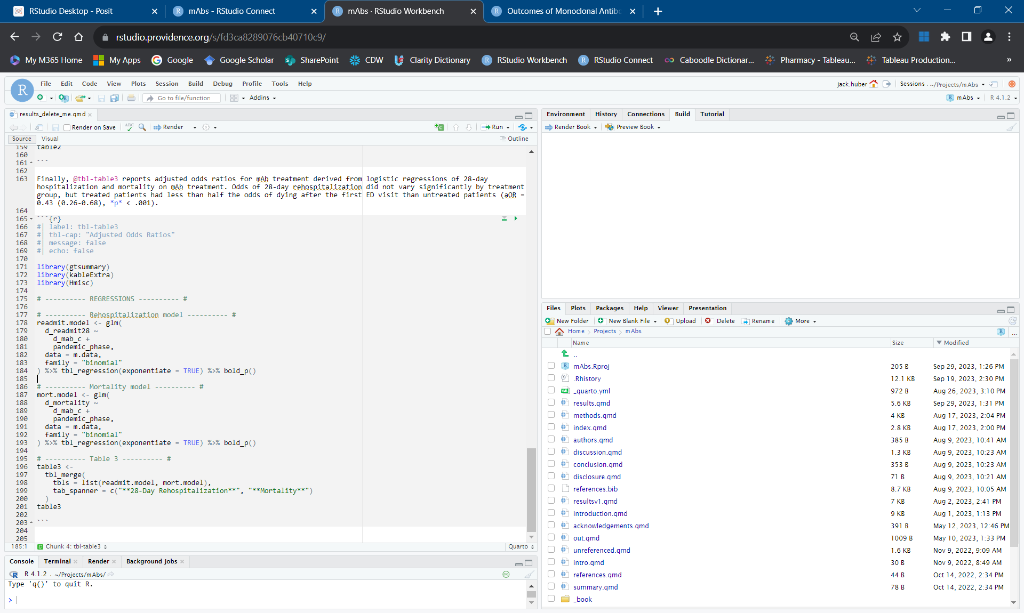
How do I do a logistic regression? An R implementation
HTML output
Quarto / R Markdown document
text
code chunk

Slide 20
Additional resources
Visualizations of statistical concepts at https://rspsychologist.com/
Statistical decision trees in Simpson (2015)
statology.org
quarto.org
SharePoint page for this presentation: Tools and Tips for Statistical Data Analysis

Slide 21
References
Arnold, L.D., Braganza, M., Salih, R., & Colditz, G.A. (2013). Statistical trends in the Journal of the American Medical Association and implications for training across the continuum of medical education. PLoS ONE 8(10): e77301.
Cohen, J. 1988. Statistical power analysis for the behavioral sciences. Lawrence Erlbaum.
Horton, N.J. & Switzer, S.S. (2005). Statistical methods in the journal. New England Journal of Medicine 353:1977-9.
Lee CM, Soin HK, Einarson TR. Statistics in the pharmacy literature. Annals of Pharmacotherapy. 2004 Sep;38(9):1412-8.
Newsome, C., Ryan, K. Bakhireva, L., & Sarangarm, P. (2019). Breadth of statistical training among pharmacy residency programs across the United States. Hospital Pharmacy 53(2): 101-106.
Ou, F.-S., Le-Rademacher, J.G., Ballman, K.V., Adjei, A.A., & Mandrekar, S.J. (2020). Guidelines for statistical reporting in medical journals. Journal of Thoracic Oncology 15(1): 1722-6.
Panos, G.D. & Boeckler, F.M. (2023). Statistical analysis in clinical and experimental medical research: Simplified guidance for authors and reviewers. Drug Design, Development and Therapy 2023:17, 1959-1961.
Simpson SH. Creating a Data Analysis Plan: What to Consider When Choosing Statistics for a Study. Can J Hosp Pharm. 2015 Jul-Aug;68(4):311-7. doi: 10.4212/cjhp.v68i4.1471. PMID: 26327705; PMCID: PMC4552232.
Windish, D.M., Huot, S.J., & Green,M.L. (2007). Medical residents’ understanding of the biostatistics and results in the medical literature. JAMA 298(9): 1010-1022.
Yi, D., Ma, D., Li, G., Zhou, L., Xiao, Q., Zhang, Y., Liu, X., Chen, H., Pettigrew, J.C., Yi, D., Liu, L., & Wu, Y. (2015). Statistical use in clinical studies: Is there evidence of a methodological shift? PLoS ONE 10(10): e0140159.

Slide 22
Thank you!
Swedish Learning & Celebration Day 2023​

